Slide 1


Titolo presentazione sottotitolo
Reinforcement learning for drone stabilization
Milano, XX mese 20XX
Drone stabilization using TF agents and Airsim

Slide 2
Summary
Drone stabilization
Brief introduction to AirSim and TF agents
Main architectures
State space, action space and reward
Empirical suggestion
Results and conclusion
Poretti Lorenzo, Restifo Alessandro

Slide 3
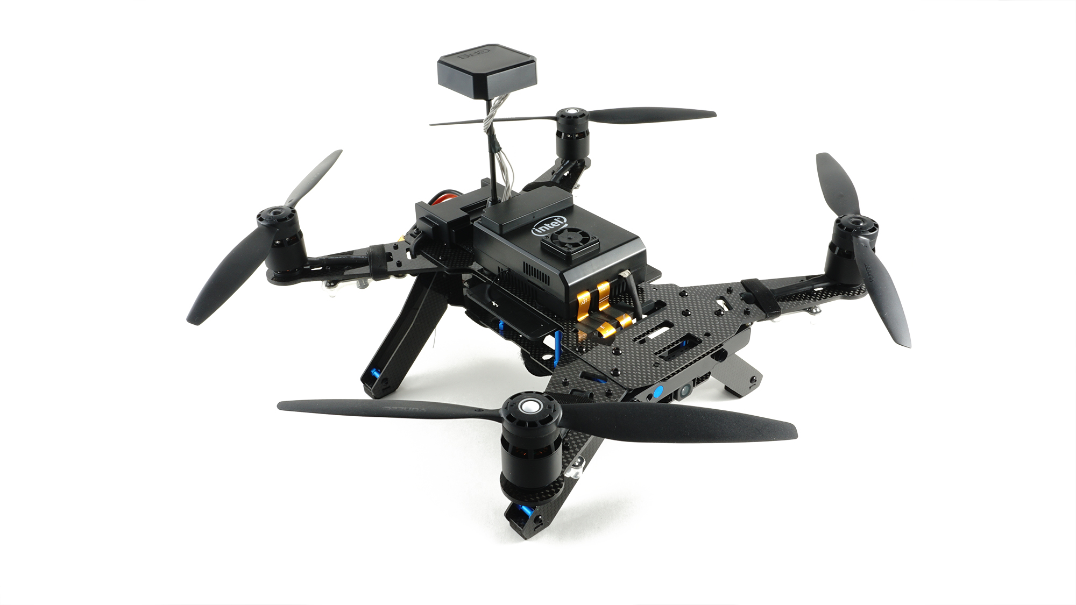
Drone Stabilization
Poretti Lorenzo, Restifo Alessandro

Slide 4
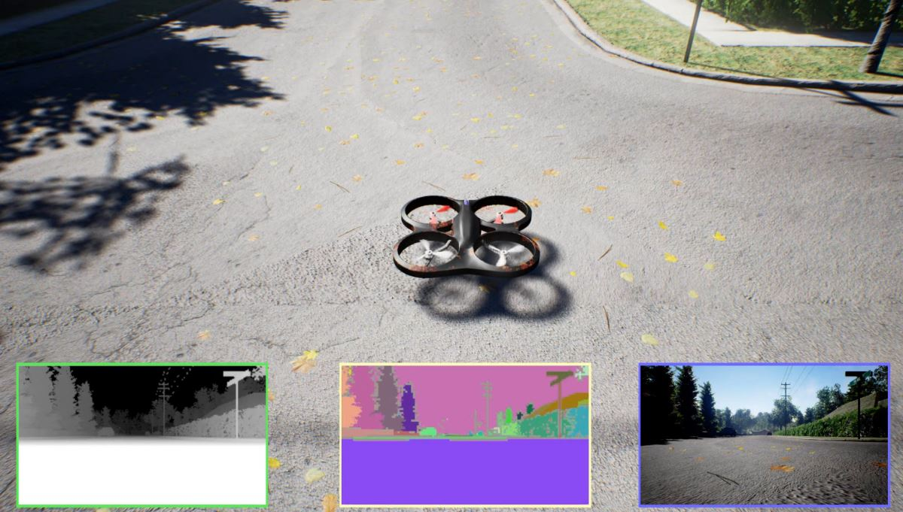
Brief introduction to AirSim
What is AirSim?
AirSim is a open-source simulator for drones built on Unreal Engine.
Poretti Lorenzo, Restifo Alessandro

Slide 5


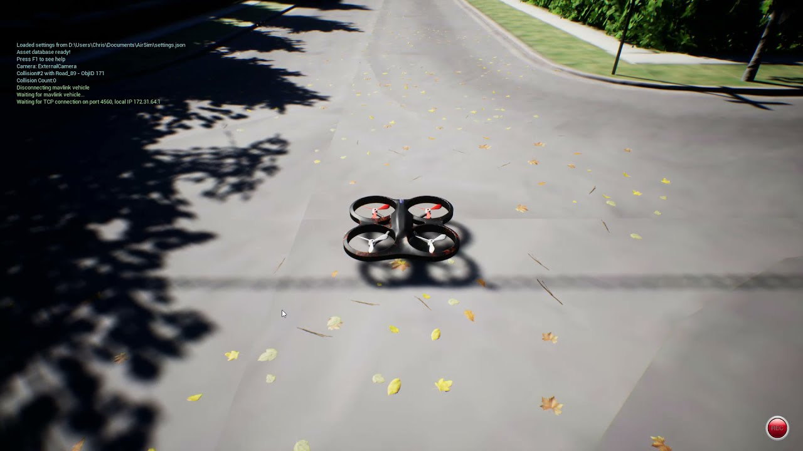

Brief introduction to AirSim
Not only a simulator…
AirSim exposes APIs to retrieve data and control directly vehicles in the simulator.
https://arxiv.org/pdf/1705.05065.pdf
https://microsoft.github.io/AirSim/
https://microsoft.github.io/AirSim/api_docs/html/
Poretti Lorenzo, Restifo Alessandro

Slide 6

Brief introduction to TF Agents
What is TF Agents?
TF Agents is a TensorFlow library to design RL algorithm
https://www.tensorflow.org/agents
Poretti Lorenzo, Restifo Alessandro

Slide 7
State Space
Numpy array of 19 elements which represent the state of the drone
Pose (X,Y,Z)
Orientation (X,Y,Z,W)
Angular acceleration (X,Y,Z)
Angular velocity (X,Y,Z)
Linear acceleration (X,Y,Z)
Linear velocity (X,Y,Z)
Poretti Lorenzo, Restifo Alessandro

Slide 8
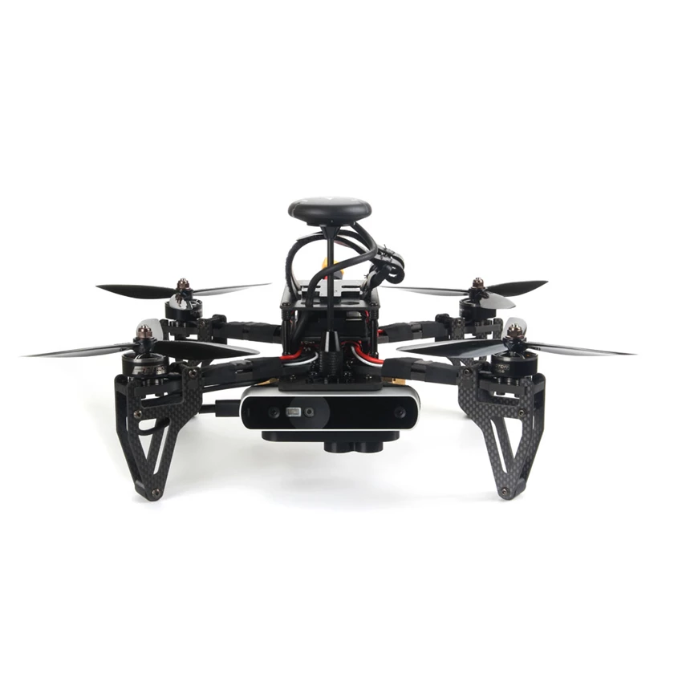
Action Space
Four motors pwm
rear_right_pwm (RR)
rear_left_pwm (RL)
front_left_pwm (FL)
front_right_pwm (FR)
RR
RL
FR
FL
Poretti Lorenzo, Restifo Alessandro

Slide 9
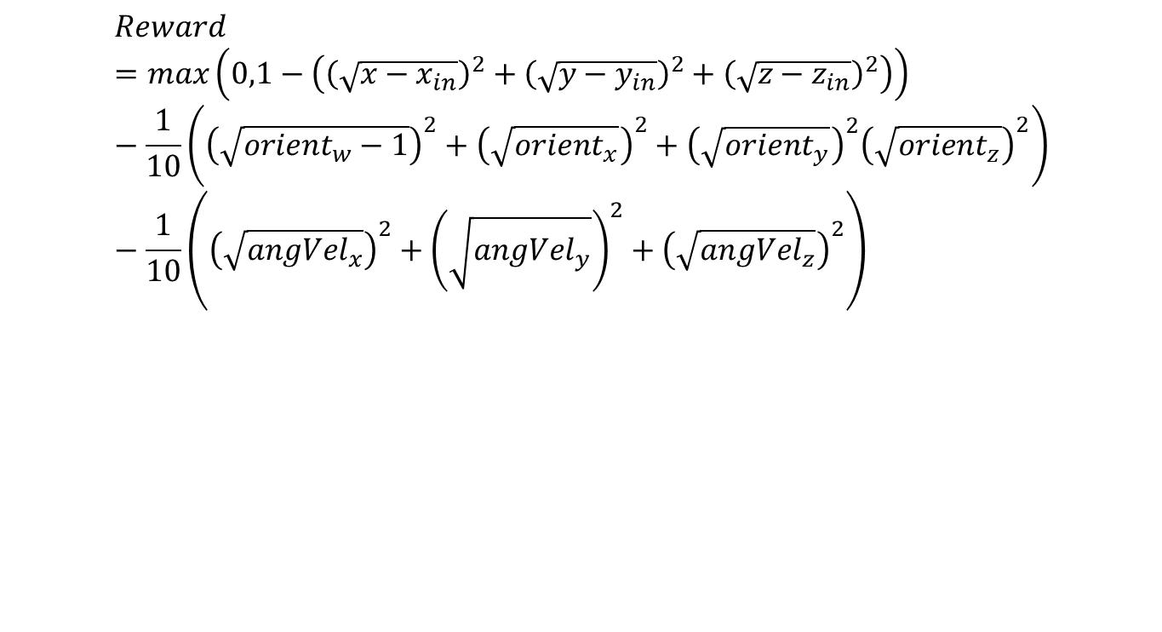
Reward
$$Reward=max\left(0,1−\left({\left(\sqrt{x−x_{in}}\right)}^{2}+{\left(\sqrt{y−y_{in}}\right)}^{2}+{\left(\sqrt{z−z_{in}}\right)}^{2}\right)\right)−\frac{1}{10}\left({\left(\sqrt{orient_{w}−1}\right)}^{2}+{\left(\sqrt{orient_{x}}\right)}^{2}+{\left(\sqrt{orient_{y}}\right)}^{2}{\left(\sqrt{orient_{z}}\right)}^{2}\right)−\frac{1}{10}\left({\left(\sqrt{{angVel}_{x}}\right)}^{2}+{\left(\sqrt{{angVel}_{y}}\right)}^{2}+{\left(\sqrt{{angVel}_{z}}\right)}^{2}\right)$$
Poretti Lorenzo, Restifo Alessandro

Slide 10
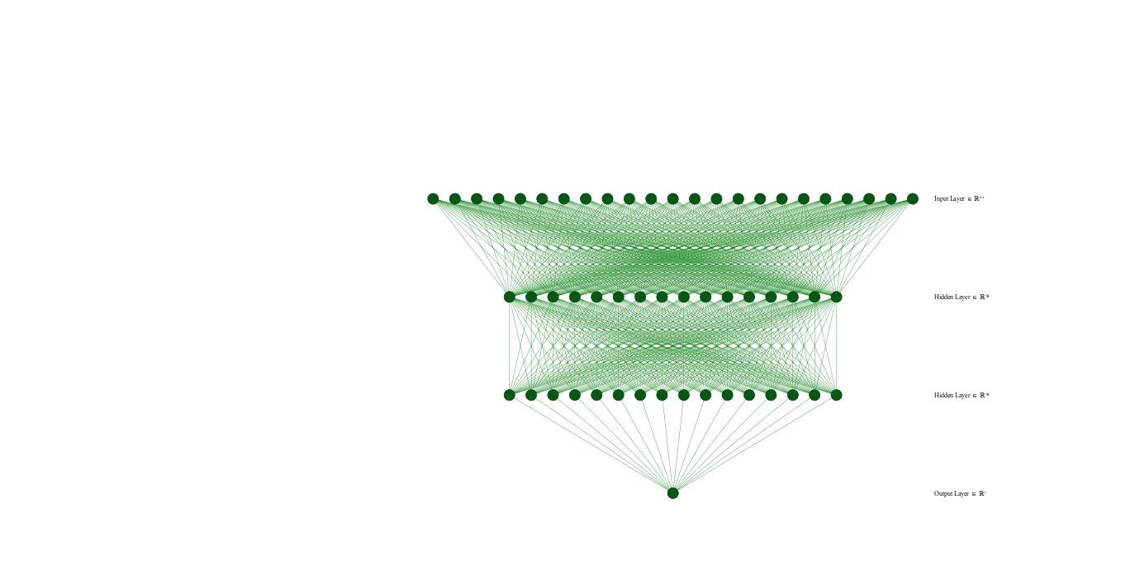
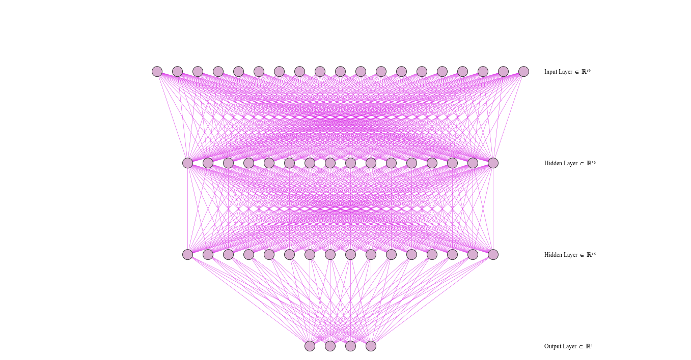
Actor Critic Network
Critic
Actor
http://alexlenail.me/NN-SVG/index.html
Poretti Lorenzo, Restifo Alessandro

Slide 11
TF Agents Environment
class DroneEnvironment(py_environment.PyEnvironment):
def __init__(self, enable_wind=False, randomize_initial_pose=False):
# Connection to AirSim as AirSim Client
# Define action space and observation space specifications
# Initialize reward to 0
def _reset(self):
# Reset the Environment
# Reset the drone in the initial pose
def _step(self, action):
# performs an action
# retrieves the reward
# returns either the transition or the termination signals associated
def move(self, action, duration=0.002, continuous=False):
# Check for the termination condition
\ # Moves the drone as specified by the action
# Action is given by the agent in output
def reward_function(self, pose):
# Given the pose returns the reward

